Slide 1
September 6, 2023
Demo
sizeup.info/delaware

Slide 2
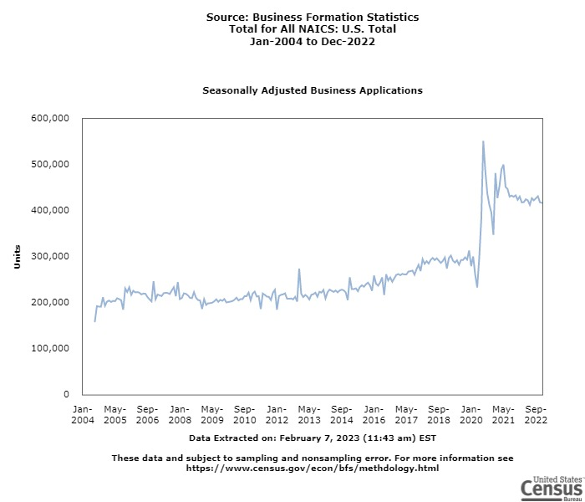
United States

Slide 3
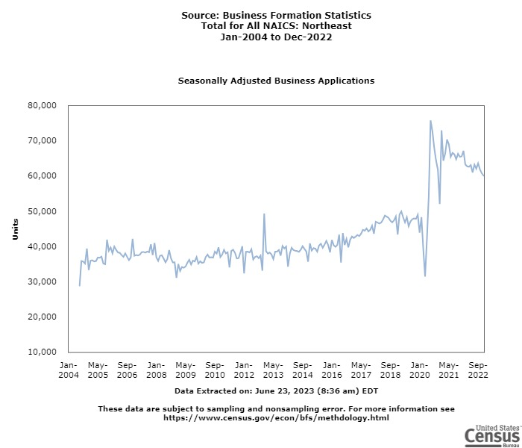
Northeast

Slide 4
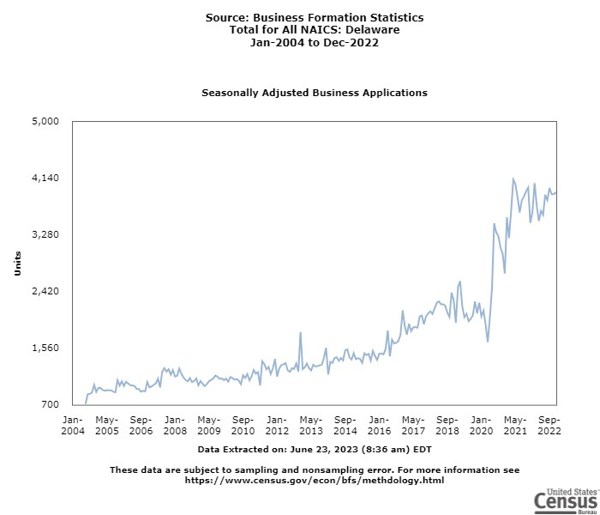
Delaware

Slide 6
Why An Online Business Intelligence Tool?
Same data BIG businesses use to optimize decision-making
Provides access after hours or weekends when businesses need it
Simple to use
Report creator which can be used online to offline

Slide 7
Retail
Restaurants
Italian
Pizza

Slide 8
Transportation
Automotive
Vehicle Maintenance
Motor Repair

Slide 9
Nation
State
Metro
County
City
Neighborhood

Slide 10
SizeUp Core Modules + Advanced Demographics
My Business Ranking
Objective data on how your business is performing versus industry competitors.
Competition
Analyze your business ecosystem to discover potential customers, suppliers and competitors.
Advertising
Maximize your marketing dollar by more accurately targeting your ideal customers.
sizeup.info/delaware

Slide 11
High-quality business intelligence data
Demographic
Industry
Geographic
Data
Transport.
Labor
Consumer
Wage
Cost
© SizeUp | Confidential

Slide 12
Demographic
Industry
Geographic
Transport.
Labor
Consumer
Wage
Cost
© SizeUp | Confidential

Slide 13
Data Sources
Industry
Demographic
Geographic
100s of public data sources
US Census
Google Maps
Bureau of Labor Statistics
Federal Business Filings
Bureau of Economic Analysis
Local Government
Internal Revenue Service
Professional Licenses
US Dept. HUD
Public
U.S. Patent Office
County Courthouse Filings
United States Postal Service
US EPA
Proprietary
Annual Reports
Medicare statistics
14M+ Businesses
Commercial Data Providers
Internal
Internal
© SizeUp | Confidential

