Slide 1
Small Business Development Center
D E L A W A R E
STATE’S SMALL BUSINESS CREDIT INITIATIVE
INFORMATION SESSION

Slide 2
AGENDA
Welcome & Introductions:
Troy Farmer – SBDC SSBCI Program Manager
J. Michael Bowman – SBDC State Director
CEO Delaware Technology Park, Inc
Regina Mitchell, Director, Division of Small Business
Division of Small Business (DSB):
Andrew Harton - Business Finance Director
Del-One:
Jory Moore, Commercial Loan Processor
True Access Capital:
Lorenzo Merino – SVO, Director of Lending
SBDC:
Tom Thunstrom – SBDC Center Director
Troy Farmer – SBDC SSBCI Program Manager
Q & A:
Andrea Wojcik – Communications Director
SSBCI
INFORMATION SESSION

Slide 3
State Small Business Credit Initiative (SSBCI) Program Overview

Slide 4
Delaware’s SSBCI Programs
SSBCI is a federal program administered by the U.S. Department of the Treasury, created to strengthen state programs that support private financing to small businesses.
DSB provides funding to banks, credit unions and other lenders for eligible loans to small businesses and loan risk-mitigation
Delaware was awarded $60.9 million for four programs. Two of which support small business lending:
Lending Programs
Delaware Loan Participation Program
Delaware Capital Access Program
de.gov/ssbci
Notes:
Other lenders = CDFIs like True Access Capital
Program details and fact sheets can be found on our website at de.gov/ssbci

Slide 5
How can SSBCI Funds Help Small Businesses?
SSBCI funds can be used for any business purpose, including:
• Start-up costs and working capital
• Franchise fees
• Equipment
• Inventory
• The purchase or improvements of an eligible place of business
SSBCI can help if an owner needs credit but the small business:
• Doesn’t have much collateral
Is having trouble obtaining a loan
Notes:
One of the most common questions we have regarding SSBCI Funded programs, is how the funding can be used. We will talk about unallowable costs on the next slide. SSBCI funds are really intended to target those that business that need access to funding, but fall behind on one or more credit metrics, such as lacking collateral, and having trouble obtaining a loan.

Slide 6
What Uses of SSBCI Funds are NOT Allowed?
Acquiring or holding passive investments in real estate*
Purchasing securities or lobbying activities
Repayment of income taxes, or the payment of payroll or sales tax
Purchase any portion of the ownership interest of any owner of the business
Used in combination with SBA-guaranteed loan or unguaranteed portion of any other federal loan*
*Exceptions to this prohibition may apply
Notes:
Here we see a list of prohibited uses of SSBCI funds, such as investing in passive real-estate, purchasing securities, or lobbying activities.
This list does not reflect all dis-allowed uses, nor does it address some of the special exceptions that may apply to these restrictions.
Example/Exception - Passive Real Estate - Buying land or real estate (commercial or residential) that you plan on renting to a tenant – Unless your business IS the tenant.
Another example would be the use of SSBCI funds in combination with another federal loan program. Generally speaking, that is prohibited, but, with prior written consent of the Treasury, that action may be allowed – especially if the two projects are separate.

Slide 7
What Businesses are Eligible?
Most Delaware small businesses, including corporations, partnerships, sole-proprietors, independent contractors, nonprofits, and cooperatives are eligible
Must have less than 500 employees for Capital Access Programs, and less than 750 employees for Loan Participation Programs
Cannot be a business engaged in speculative activities (i.e.: flipping properties)
Cannot be a business engaged in pyramid sales
Cannot make, sell, service, or distribute products or services used in connection with federally prohibited activities (ex. direct or indirect marijuana business)
Notes:
Speculative activities are when you buy an investment on the premise that the price of that investment will go up at a later date and you will sell it, for example: stock trading, purchasing and holding land, flipping properties.

Slide 8
Delaware Loan Participation Program (DELPP)
PROGRAM PURPOSE
Helps small businesses obtain medium to long-term financing, usually in the form of loans, to help businesses grow and expand
Especially useful when a lender is unable to loan the business as much as requested
DSB uses SSBCI dollars to fund a portion of a loan administered by a Participating Lender (bank/credit union/other lender)
Prefer loans of 5-years or less, with a maximum of 10-year loans
Notes:
Now let’s talk about the first of our two lending programs – the Delaware Loan Participation Program.
This is a good option for a 5 – 10 year loan when the bank won’t lend you the full amount you requested, due to your level of risk of defaulting.
Note that DSB will only cover up to 50% of the requested loan. So if your bank isn’t willing to cover at least half, this program is not for you.
As mentioned at the start, once you are referred to the bank for this program, that’s the only entity you have to deal with. We will provide our portion of the funding to the bank so you don’t have to manage two sets of loans.
We would prefer to participate in loans that are medium to long-term, with most loans being preferably five years or less, and a maximum loan term of 10 years.

Slide 9
DELPP Key Program Characteristics
DSB lends at prime interest rate
The lender will often have a higher interest rate. This blended interest rate between DSB and the lender, is better for the borrower
Amounts greater than $500,000 (for DSB’s portion) require additional approvals
Total loan requests (not just our portion) must not exceed $5M
While the borrower may start with us, ultimately, they will deal only with the bank for paperwork, the loan, etc.
Notes:
Here we have some key program characteristics.
Additional approvals = CDF

Slide 10
Delaware Capital Access Program (DCAP)
PROGRAM PURPOSE
Provides supportive financing to a business that has minor collateral or credit issues
Especially beneficial for those who are, or live in, socially or economically disadvantaged areas (also known as SEDI), or are a very small business (<10 employees)
A risk-pooling concept where multiple borrowers within the same lending institution contribute payments to the same reserve fund that the lender can use as collateral to support a loan
Preference is also 5-year loans or less, with a maximum of a 10-year loan
Notes:
A business is considered SEDI-Owned if at least 51% of that business is owned by SEDI individuals. - categories include minority, women, veteran, disabled, LGTBQ+, have limited English proficiency, and live or have a business in an economically disadvantaged or rural area

Slide 11
Where do I Start?
A business owner can start by speaking to a Division of Small Business, Regional Business Manager.
The Business Manager will listen to the details of your project and help you decide if:
You might qualify for one of them – if yes, and you are “bank-ready” you will be given the list of participating lenders to choose from.
If you might qualify but are not “bank-ready” we will connect you with a Resource Partner to help get you there
If you do not qualify, we will educate you on other available incentive programs

Slide 12
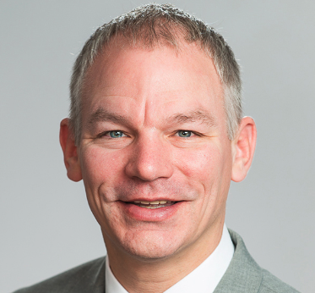
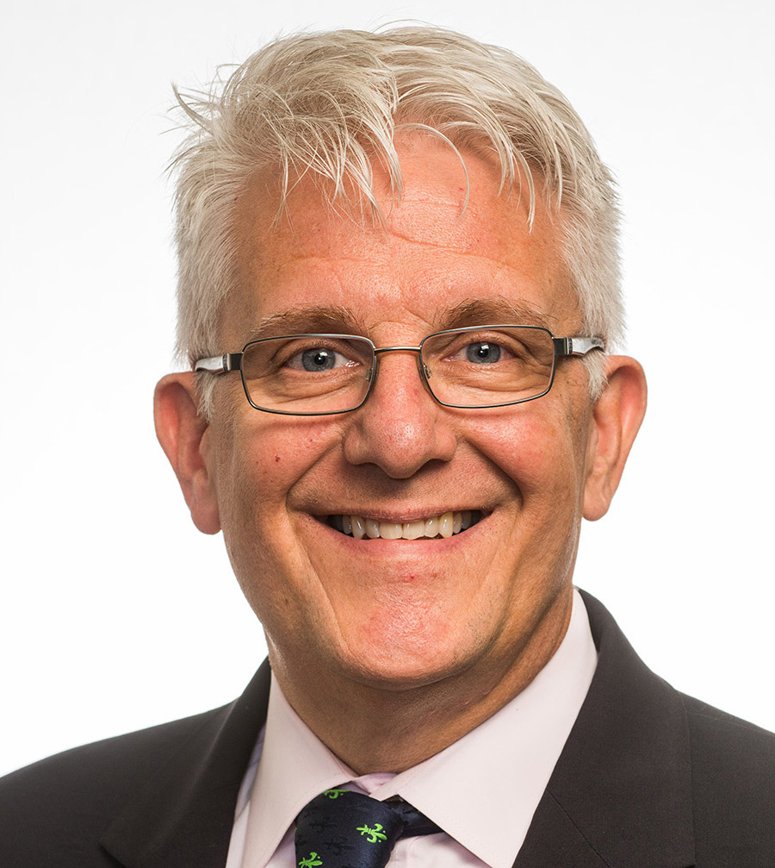
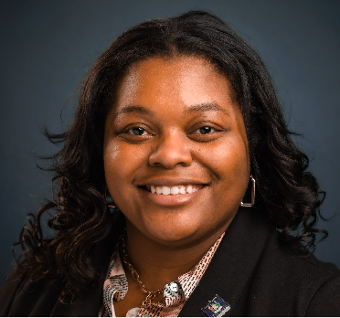
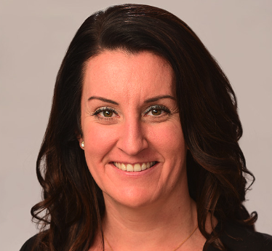
Additional Questions? DSB Regional Business Managers
Joe Zilcosky
Northern New Castle County
Joe.Zilcosky@delaware.gov
David Mathe
Southern New Castle County
David.Mathe@delaware.gov
Anastasia Jackson
Kent County
Anastasia.Jackson@delaware.gov
Lauren Swain
Sussex County
Lauren.Swain@delaware.gov

Slide 13
Who are Participating Lenders?
Del-One Federal Credit Union
https://www.del-one.org/business-loans/
True Access Capital
https://trueaccesscapital.org/contact/
Notes:
Currently we only have two participating lenders – our First to sign on was Del-One Federal Credit Union, and the most recent was True Access Capital.
We are actively looking for other banks to participate. Delaware-only banks – meaning not having branches in other states, credit unions and Community Development Financial Institutions (CDFI) seem to be the best fits for this program.

Slide 14
Visit: de.gov/ssbci

Slide 15
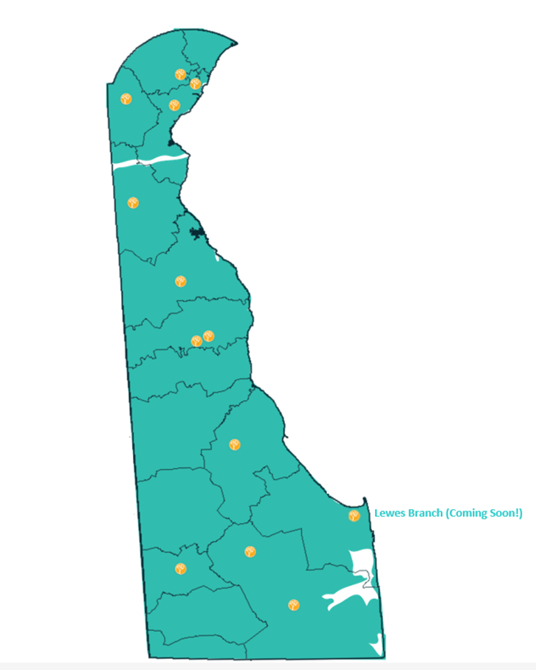
Del-One Federal Credit Union has been proudly helping members reach their goals since 1960. Our member-owned financial cooperative’s staff work as advocates by learning what our members need and want and assisting them on their financial journey. Del-One is more than just a full-service financial institution with branch locations throughout Delaware—it is a place where members are treated like family.

Slide 16
Products and Qualifications
Business Plan
Business Loan Application
Organizational Documents
(Operating Agreement, Articles of Incorporation, etc.)
Personal Financial Statement
Include copies of Bank Statements
l Include copies of Brokerage Statements
2 years of Personal Tax Returns
l Include copies of W2s, 1099s and other supporting schedules
2 years of Business Tax Returns
Income Statement and Profit & Loss Statement
Balance Sheet
CONTACT US:
PHONE: (302) 608-0661
EMAIL: businessloans@del-one.org
APPLY ONLINE!
https://del-one.akouba.io/

Slide 17
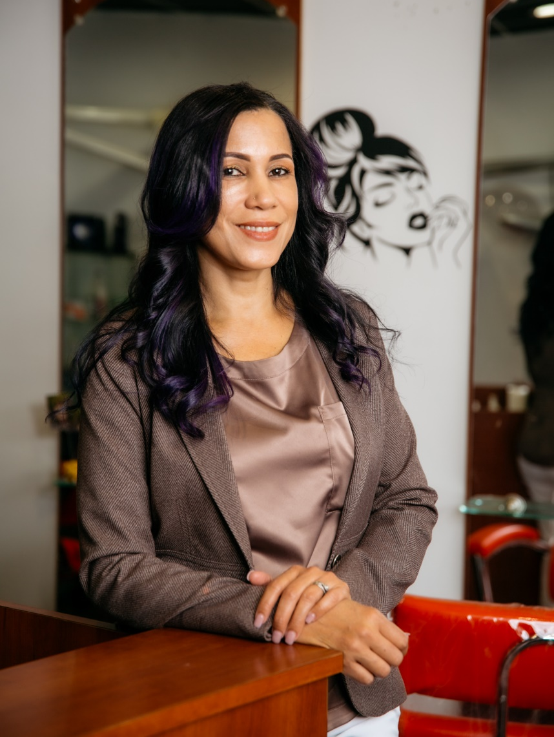
True Access Capital is a Community Development Financial Institution (CDFI) that offers access to capital, technical assistance and business support to small businesses and entrepreneurs, located in Delaware, and in Southeastern Pennsylvania. Our mission is building a thriving community by empowering a diverse base of entrepreneurs and businesses through access to capital, education, advocacy and opportunity.
Why TAC?
Ineligibility for traditional financing for reasons that include but are not limited to: Start up business, risky industry, collateral shortfall, low credit,
equity/downpayment shortfall
Contact Information:
Lorenzo Merino, lomerino@trueaccesscapital.org
Office: 302-652-6774

Slide 18
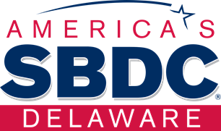
The SBDC brings the resources of UD, the SBA, and the State to your business. Our role as technical advisors:
Help businesses develop a business plan to start or scale
Improve strategic & operational performance
Identify & access capital, such as SSBCI
Prepare financial projections
We can additionally…
Conduct market research & analysis
Develop business resiliency & continuity strategies
Bid & win government contracts
Access resources for R&D and commercialization (including intellectual property protection and technology transfer)
Increase awareness of cyber risks & security protocols
Explore & implement digital marketing & e-commerce solutions

Slide 19
Our Role With SSBCI Technical Advising
Once you speak with a Division of Small Business Regional Business Manager, they will refer you to the SBDC for advising.
Our advising sessions are generally via Zoom.
We work with you to review and improve your business plan and your financial projections. While we won’t write your plan nor predict your sales or bottom line, we’ll be happy to help strengthen your application and budget!

Slide 20
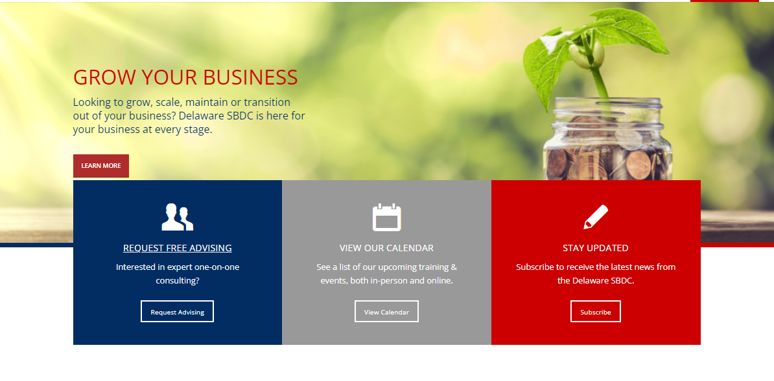
How To Request Advising
Visit our website (delawaresbdc.org)
Click the blue box to request advising with us
Follow the prompts, selecting the county that you reside in, and fill out as much information as possible (process takes about 10 minutes).
If you are referred to us, please list who referred you!

Slide 21
SBDC UPCOMING EVENTS:
The following upcoming events are in partnership with the Division of Small Business, the Emerging Enterprise Center and Wilmington Alliance:
MAY 23RD – The Do's and Don'ts of Creating a Small Business Plan for Funding
Audrey Scott-Hynson
MAY 29TH – Ins and Outs of Financial Statements for Your Business
Omar Mitchell
To register for the upcoming events, please go to the SBDC Events Calendar at:
https://delawaresbdc.org/training/events/#start_date=2024-05-01

Slide 22
SBDC UPCOMING EVENTS:
HOW TO LEARN ABOUT UPCOMIMG EVENTS:
Go to the Delaware SBDC's website to join our E-mail List and subscribe to our Newsletter at:
https://delawaresbdc.org/
To learn more about the DSB's events please go to the Division of Small Business's Calendar at:
https://business.delaware.gov/events-calendar/

Slide 23
Q & A
Andrea Wojick
Division of Small Business
Communications Director

Slide 24
Contacts
Lorenzo Merino
SVP, Director of Lending
True Access Capital
100 W. 10th St., Suite 300
Wilmington, DE 19801
Work Cell: (484) 243-0961
Office: (302) 652-6774 ext. 124
www.trueaccesscapital.org
J. Michael Bowman
State Director, OEIP
Small Business Development Center
591 Collaboration Way, Suite 204
Newark, DE 19713
Andrew Harton
Business Finance Director
Delaware Division of Small Business
Office: (302) 672-6838
andrew.harton@delaware.gov
Adrián G. Romero, CUBDP Asst. Director of Retail Operations NMLS#: 1237287 270 Beiser Blvd.
Dover, DE 19904 Ph: (302) 739-4496 ext. 1441 Adrian.Romero@Del-One.org
Troy Farmer
SSBCI Program Manager
Delaware Small Business Development Center
591 Collaboration Way, 2nd Floor
Newark, DE 19716
Office Tel: 302-831-0777
tfarmer@udel.edu
Regina Mitchell
Director
Delaware Division of Small Business
99 Kings Highway
Dover, DE 19901
302-739-4271
Andrea Wojcik Director of Communications Office: (302) 672-6840 andrea.wojcik@delaware.gov
Jory Moore,
Commercial Loan Processor
Del-One Federal Credit Union
jory.moore@del-one.org
Tom Thunstrom
Center Director
Small Business Development Center University of Delaware
103 W. Pine Street
Georgetown, DE 19947
Office: 302.831.0773
www.delawaresbdc.org
Chavonya Reddick
Del-One Federal Credit Union
chavonya.reddick@del-one.org

