Slide 1
Delaware Statewide Bonding
Pilot Program
Presented by The Delaware Office of Supplier Diversity, in collaboration with Embrace Partners.

Slide 2


Agenda
  Welcome
  Housekeeping Items
  Introductions
  Program Details
  How to Apply
  Questions

Slide 3
Have a Question?
Type all questions in the Q&A box
We will post the recording and the slides for this presentation on the DSB website at de.gov/osd by noon tomorrow

Slide 4
Office of Supplier Diversity
Certification
Advocacy
Resources
Contact:
Shavonne H. White, Director
P: (302) 577-8497
E: osd@delaware.gov
Learn More & Apply for Certification:
business.delaware.gov/osd

Slide 5
Delaware Statewide Bonding Pilot Program
The Delaware Office of Supplier Diversity, in collaboration with Embrace Partners, is launching a Statewide Bonding Pilot Program. The program is designed to help small and diverse contractors obtain surety bonds and expand their ability to compete for larger construction opportunities.

Slide 6

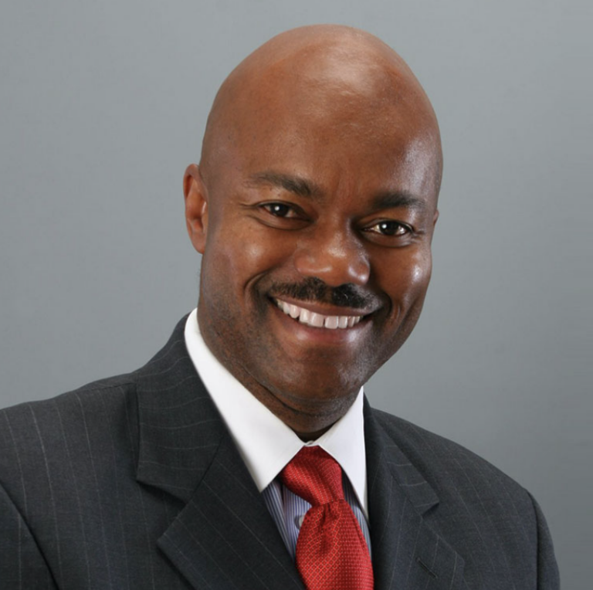
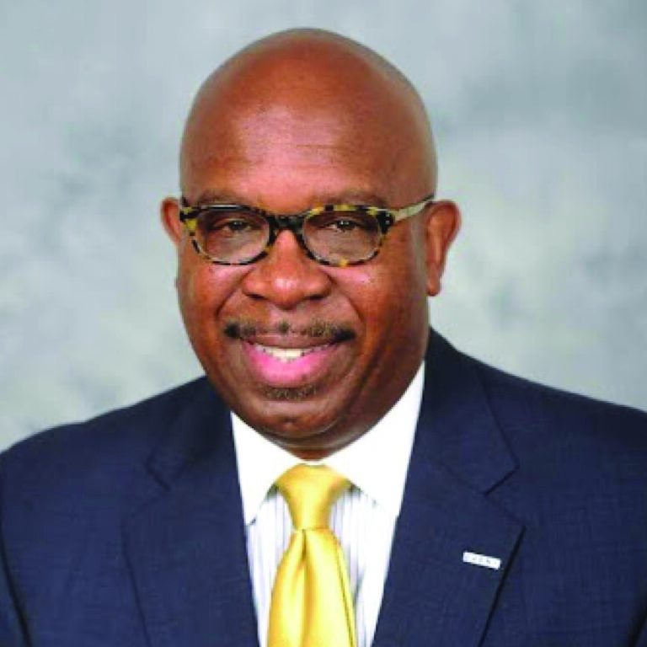

Embrace Partners
David Cayemitte
CEO
Michael M. Clay
Chief Procurement Officer
Drew Jennings
Surety Chief Underwriting Officer

Slide 7
Embrace Partners
What We Do
Wholesale Insurance Brokerage
Managing General Underwriter
Owner’s Representative for Large Construction Projects
Property and Casualty Coverage
Surety Bonding
A certified minority firm that is qualified to meet your diversity goals.
Services & Industries We Serve
Providing innovative diversity, equity and inclusion-based solutions to increase diversity in the insurance and construction industries.

Slide 8


Minority Business Development Institute
The Minority Business Development Institute (MBDI) is an innovative, community-based, non-profit organization born out of a passionate desire to “change the paradigm” of economic inequality for the minority, veteran and women contractor community.
Program Overview:
Self paced online learning
Includes eight classes on core business topics including:
  Surety Bonding
  WIP Schedule
  Cash flow
  Financials and more
Surety Bonding up to $1 million for contractors upon successful completion of the program

Slide 9
Delaware Bonding Pilot Program Details
Bond training and education for up to 30 contractors
e-Learning platform comprised of 8 courses
8-week completion timeline
Embrace Partners will offer support to participants
Acquire surety bond up to $1Million
Bond amount awarded after successful completion of program based on criteria set by Embrace Partners
Apply on-line beginning July 15 through August 29

Slide 10
Delaware Bonding Pilot Program Courses
Introduction to Bonding
Capabilility Statements
Cash Flow
Credit for Small Business
Financial Statements
WIP (Work-in-Progress) Schedule
Project Delivery
Contractual Obligations

Slide 11
Delaware Bonding Pilot Program Application
Information required to apply include:
General Information
Work History
Compliance Questions
Current Certifications

Slide 12
Questions?
Type all questions in the Q&A box
We will post the recording and the slides for this presentation on the DSB website at de.gov/osd by noon tomorrow

Slide 13
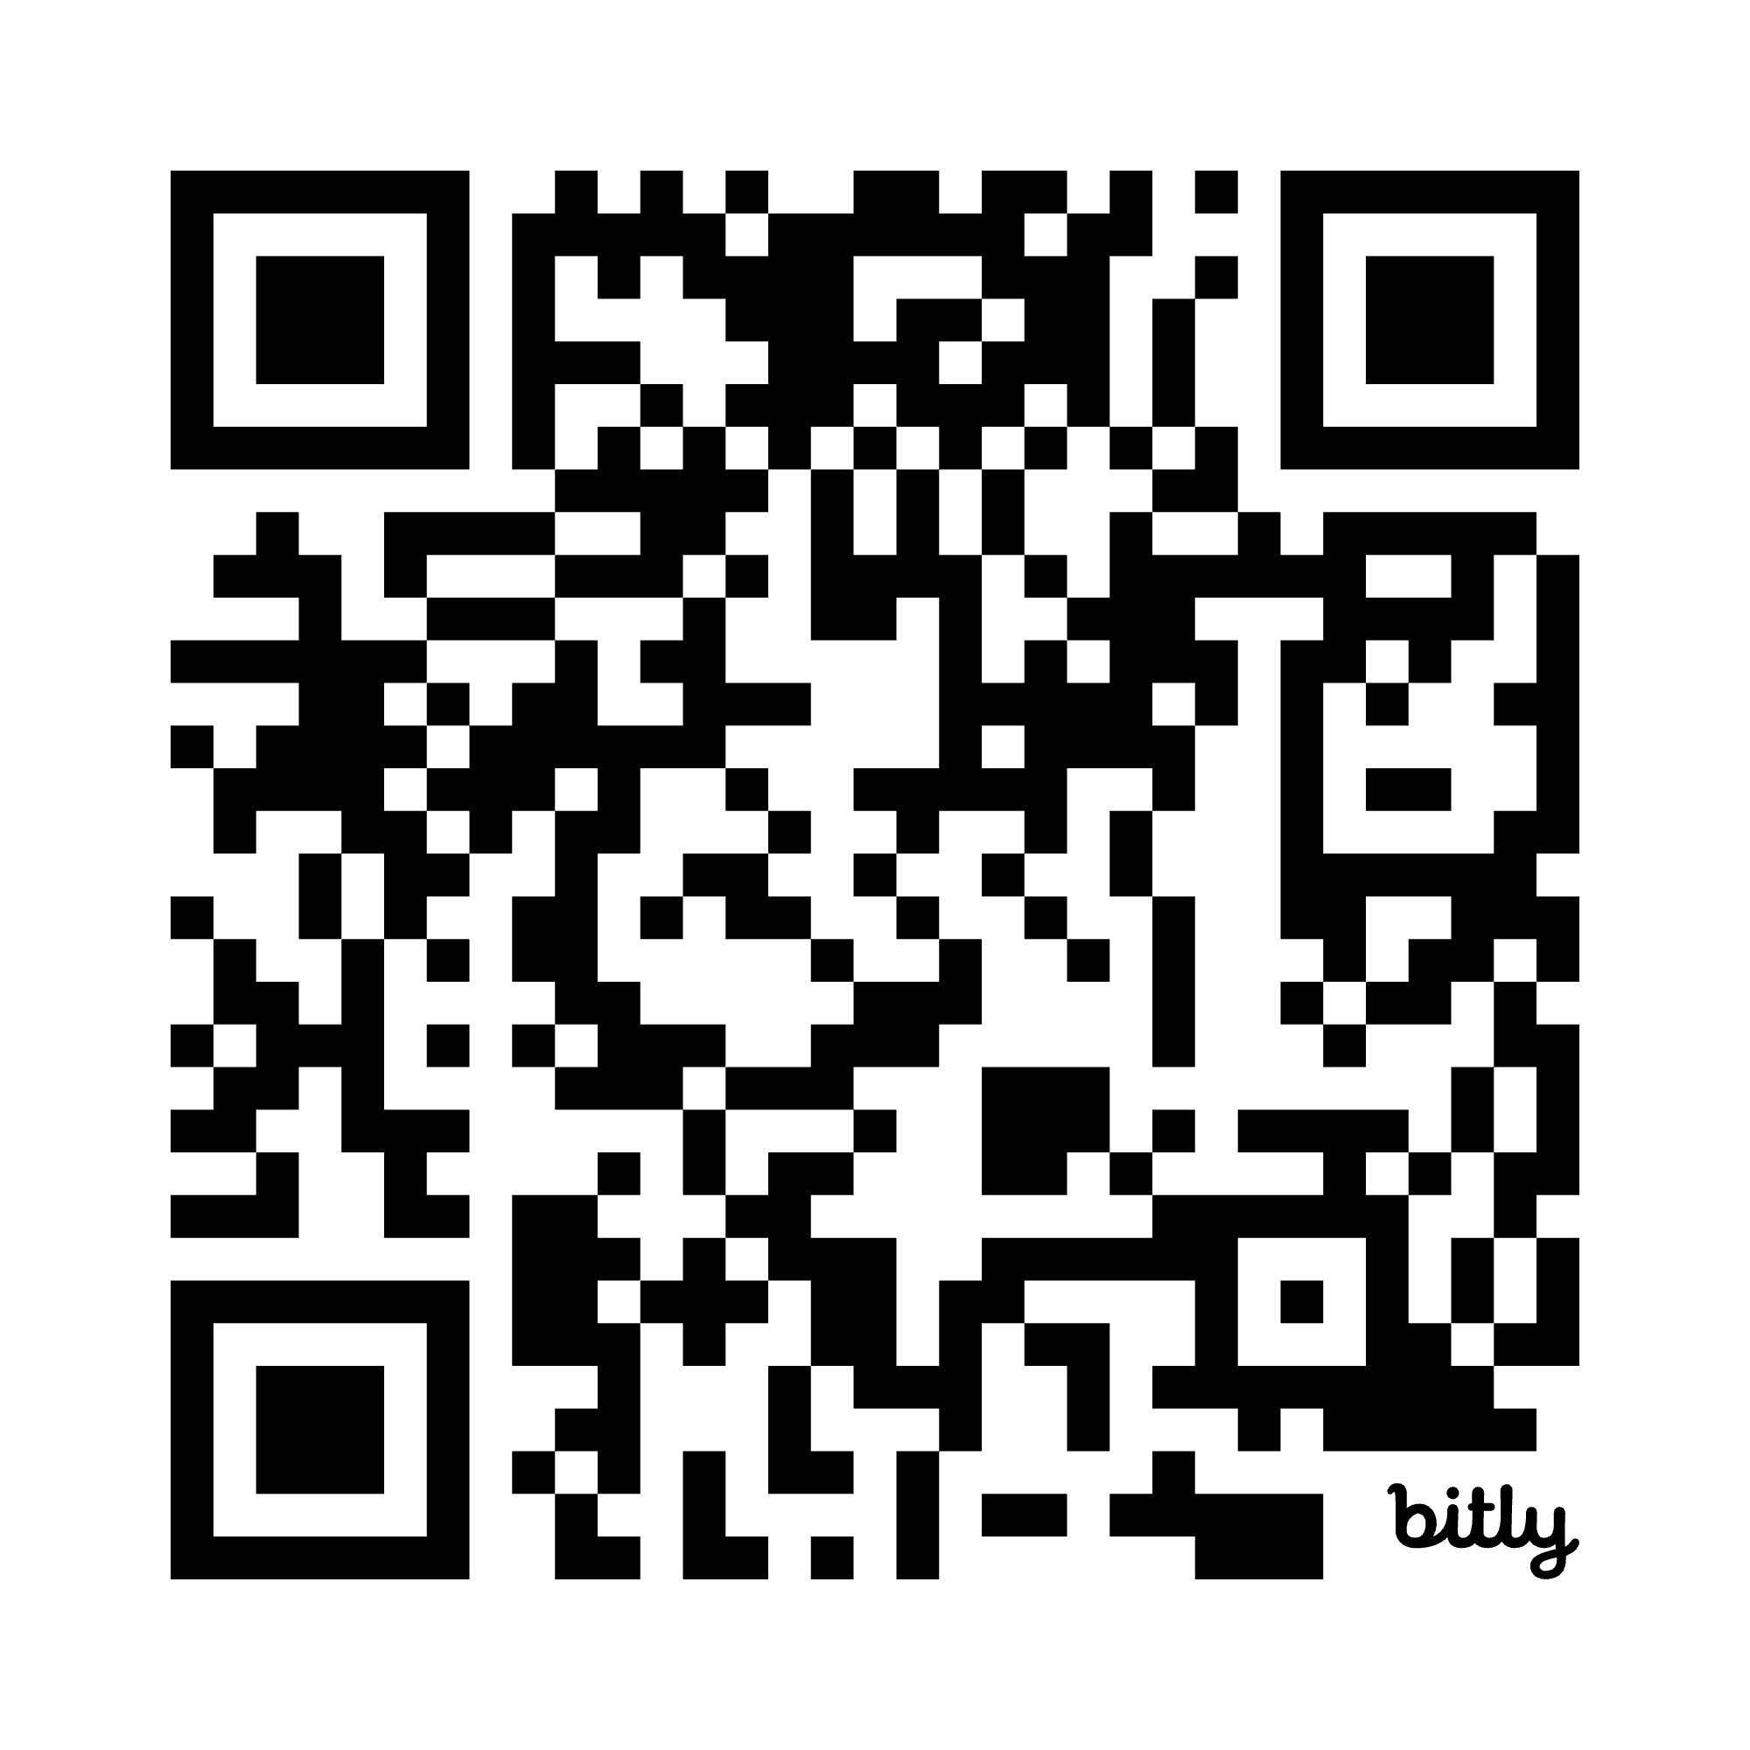
Applications accepted beginning July 15th
Deadline for applications
Friday, August 29th
4:30 p.m.
Apply bit.ly/4khyJFh

Slide 14
Thank You!

