Slide 1


How to Complete Your EDGE 2.0 Application

Slide 2

Presenters
Welcome
Andrea Wojcik, Sr. Communications Manager
EDGE Application
Jory Moore, Business Finance Director
Filling Out Your Proposal Template
Anastasia Jackson and Gemini Cornish,
DSB Regional Business Managers
Additional Tips and Resources
Andrea Wojcik
Q & A

Slide 3
Type any questions into the Q&A
The recording and the slides for this presentation will be posted at de.gov/edge by noon tomorrow.

Slide 4
Components of Your EDGE 2.0 Application
Application Form
Proposal Template
Documents to Upload

Slide 5
Completing Your Online Application Jory Moore, DSB Business Finance Manager

Slide 6
How to Complete Your Proposal Gemini Cornish Anastasia Jackson DSB Regional Business Managers
Notes:
aj

Slide 7
Steps to Apply
Download and complete your proposal
Gather other documents you will need to upload
Access the EDGE 2.0 Application at de.gov/edge
Fill out the application and upload all documents together at the same time
DO NOT WAIT UNTIL SEPTEMBER 5TH TO DO ALL OF THIS!
Notes:
aj

Slide 8
Formatting Your Proposal
Must use STEM or Entrepreneur template on website to format proposal – complete all sections! Type of business determines which template you use.
Font: Times New Roman, 12 Point
Double-Spaced
20-page maximum (EDGE application does not count towards page limit)
Save as PDF and upload when completing application
Notes:
aj

Slide 9
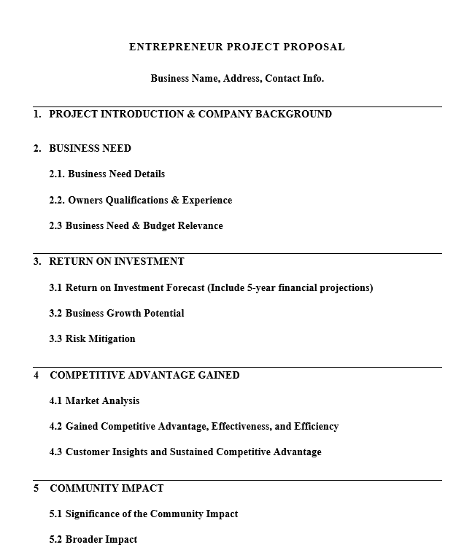
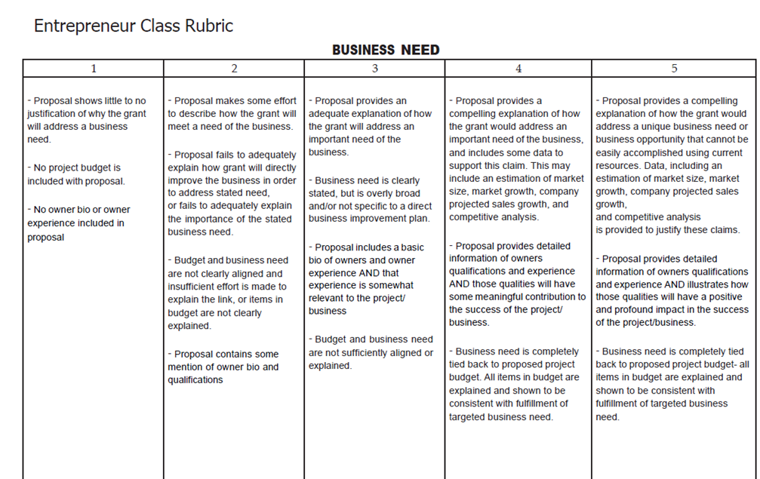
Notes:
AJ

Slide 10
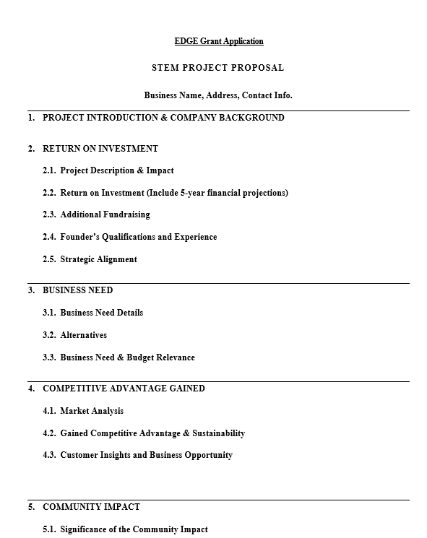
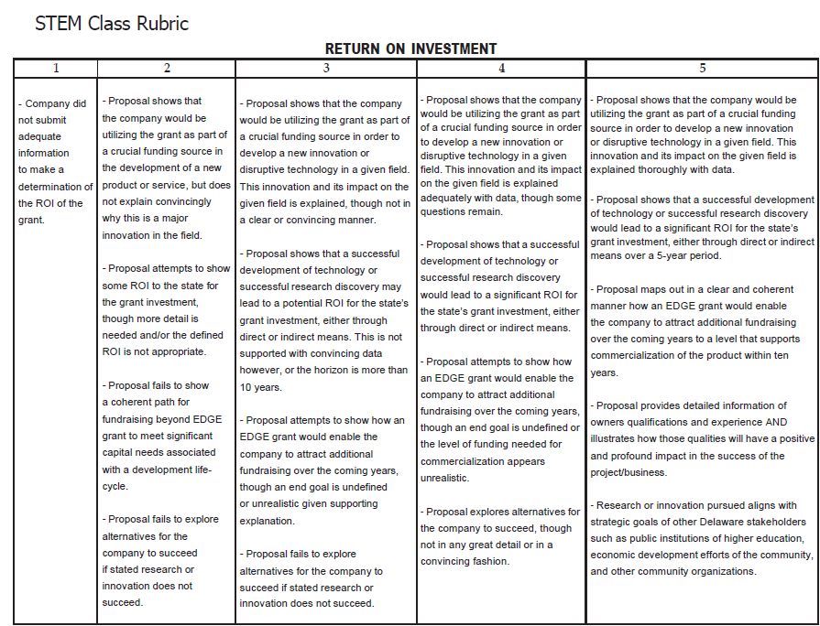
Notes:
GC

Slide 11
4 Documents You Need to Upload
Income Statement - pdf
Balance Sheet – pdf
Detailed Budget - pdf
Copy of Current (non-expired) STATE OF DELAWARE Business License (Temporary Licenses accepted if current) – pdf preferred, jpg accepted
Notes:
GC

Slide 12
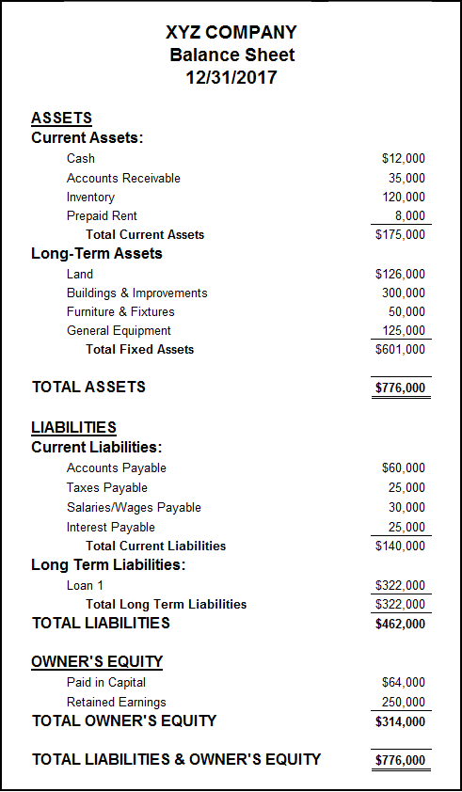
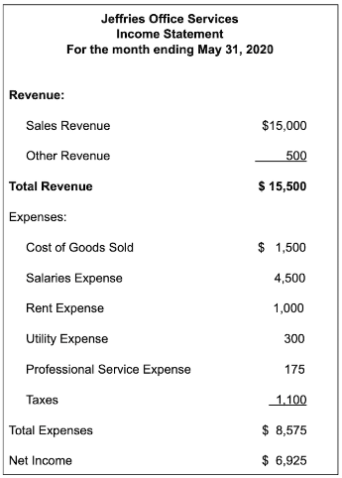
Balance Sheet vs Income Statement
Notes:
GC

Slide 13
Balance Sheet v. Income Statement
The balance sheet is a snapshot of what your business owns (assets) and how those things were funded (liabilities vs equity).
Remember, a balance sheet shows the items at the price they were purchased for or the cost incurred to make them. If you can’t put a price on it, it probably doesn’t belong on the balance sheet!
The income statement shows the flow of revenues against expenses for a given period and shows the bottom line - profit or loss.
Your business may not be making a profit yet, and that’s ok. Just remember to be as detailed as you can be in the financials and the narrative.
Notes:
GC

Slide 14
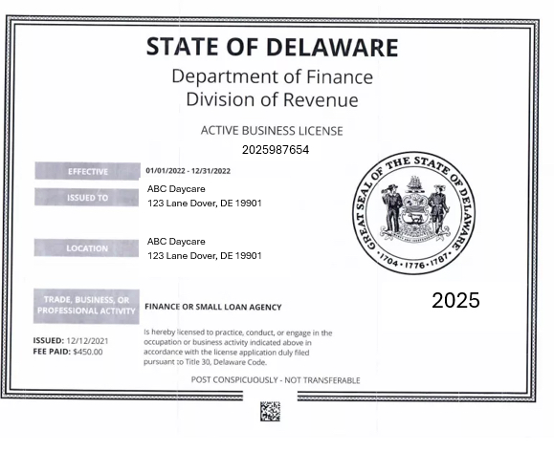
Example of Business License
Notes:
GC

Slide 15
Other Tips, Resources and Information
Notes:
AJ

Slide 16
Tips
Meet with a Business Manager to get guidance and feedback on your proposal
Do not request the upper limit of the available pot
Remember – you need to have a match for the amount you request
Notes:
AJ

Slide 17
3 to 1 Match (found in application form)
When applying you are required to show you have some level of capital
All awards require a 3:1 funding match. For example, to receive a $90,000 grant, a finalist must have secured $30,000 from other sources.
Match should be specific to this project
Other grants can be used for your match
Notes:
AJ

Slide 18
Eligible Projects
vs.
Ineligible Projects
Building infrastructure/cosmetic enhancements
Essential equipment
Rent assistance
Web site design
Market analysis assistance
Advertising assistance
Payroll expenses that are not attributed to the project outlined in the application
Salaries or payments made to company ownership
The purchase of real estate
Permits or government fees
Taxes
Improvements to residential property
Notes:
AJ

Slide 19
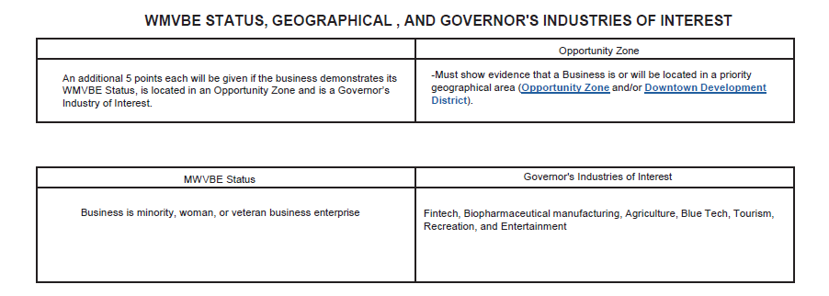
Additional Points on the application
Notes:
AJ MWVBE

Slide 20
Governor’s Industry Of Interest
Fintech
This sector aims to increase efficiency, accessibility, and convenience in financial transactions and services.
Payment processing, peer-to-peer lending, robo-advisors and block chain technology, etc.
Bio Pharmaceutical Manufacturing
Develops manufacturing of pharmaceuticals can lead to job creation in high skill sectors, increased exports and improved public health, reducing long term healthcare costs.
Vaccine production, biotechnology firms, generic drug manufacturing, etc.
Agriculture
Organic farming, precision agriculture, agribusiness supply chains, etc.
Notes:
AJ

Slide 21
Governor’s Industry Of Interest
Blue Tech
Blue tech is framed as technology used to understand, explore, and manage the marine environment, with tools such as autonomous surface vessels, underwater robotics, geospatial mapping, sensor networks. Promotes sustainable practices and increases coastal community revenues.
Aquaculture technology, marine renewable energy ( tidal and wave energy), oceanographic research , etc.
Tourism
Accommodations, Transportation (bus, car rental etc.), Attractions, Restaurants,
Notes:
AJ

Slide 22
Governor’s Industry Of Interest
Recreation
Recreational facilities and services that can improve community health and wellness while generating revenue.
Fitness centers, outdoor adventure services, gyms, outdoor adventure services (hiking, kayaking, biking) etc.
Entertainment
Theatrical productions, media, film, music, producers, performing arts ,art exhibits, and other creative endeavors that are central to Delaware's vibrant arts community.
Notes:
AJ

Slide 23

Office of Supplier Diversity
W/M/V/IBE Certification
On the application, you self-identify that you are in a certain W/M/V/IBE category. (women/minority/etc.)
Certification is not required to apply for EDGE 2.0 or to get the extra points – if you wish to pursue it give yourself time.
Assistance with state procurement opportunities
OSD Director – Shavonne H. White
osd@delaware.gov
De.gov/osd
Notes:
GC

Slide 24
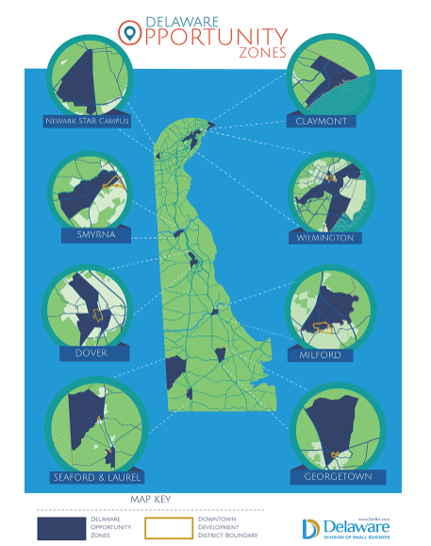
Where can I learn more?
https://business.delaware.gov/opportunity-zones/
Notes:
GC

Slide 25
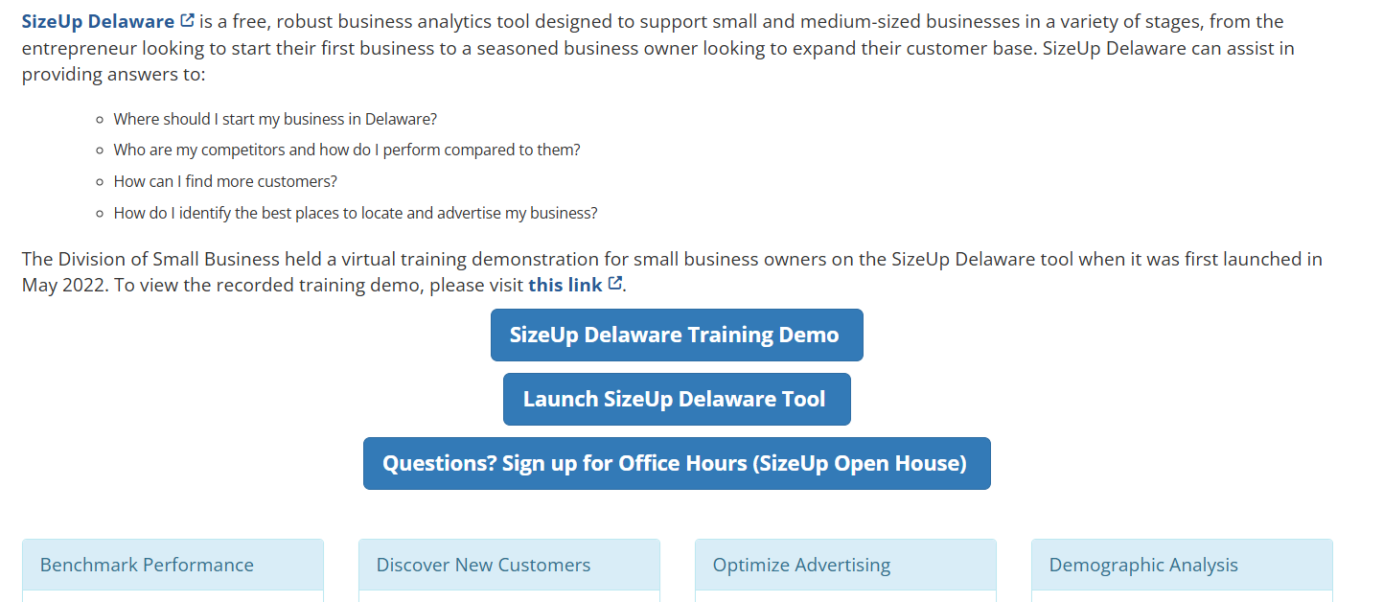
Resources
Use SizeUp Delaware for market sizing and information on competition https://delaware.sizeup.com/
Notes:
GC Pass to Andrea

Slide 26
After Application Submission
Four rounds of internal review and scoring
Judging on two separate days – one for STEM, one for Entrepreneur
Pitch days are between Oct. 28 - 30
Awards ceremony/announcement – either Nov. 12, 13, 18, or 19
Notes:
Andrea to pick up here

Slide 27
After Award
Sign grant agreements
Confirm compliance before we disburse the funds
Reporting requirements afterward
5-year commitment to remain in state
EDGE Grants are considered taxable income. Consult an accountant if you have questions about your specific situation.

Slide 28

Deadline for applications Friday, September 5th 4:00 p.m. Do Not Wait Until the Last Minute!!

Slide 29
Questions?
Type in Q & A
we will post the recording and the slides for this presentation at de.gov/edge by noon tomorrow

Slide 30



Stay Connected
Sign up for our e-newsletter
Go to business.Delaware.gov and sign up at the bottom of any page
Follow us on social media:
@delawaresmallbusiness
LinkedIn.com/company/de-smallbusiness
@delawaresmallbusiness

Slide 31
Business Managers
Joe Zilcosky: Joe.Zilcosky@delaware.gov
Industries: STEM, Fintech, Life Science, and Bio Science
Location: New Castle County
Anastasia Jackson: Anastasia.Jackson@delaware.gov
Industries: Service-based, Hospitality, Retail, and Restaurant
Location: Kent County
Gemini Cornish: Gemini.Cornish@delaware.gov
Industries: Professional Services, Agriculture, Aquaculture, and Consulting
Location: Sussex County
Notes:
Which of the three should you contact? Look at Industry first. If your industry is not listed, then go by location.

Slide 32
Thank You

