Slide 1


EDGE 2.0
Spring 2026
Informational Webinar

Slide 2

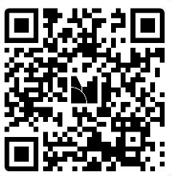

Welcome
Jaimie Watts
DSB Deputy Director
Menti Meter Questions-
Results will be revealed before Q&A
About EDGE
Joe Zilcosky
DSB Regional Business Manager
EDGE Application Requirements
Jory “JJ” Moore
DSB Finance Director
Filling Out Your Proposal Template & Rubric
Gemini Cornish
DSB Regional Business Manager
Additional Tips and Resources
Anastasia Jackson
DSB Regional Business Manager
Q & A
Join at menti.com | use code 8224 6194
Please join the Menti by scanning the QR code
Notes:
https://www.menti.com/al1k28gyzm54
Join at menti.com | use code 8224 6194
This webinar will be recorded and posted on our website de.gov/edge (by end of week?)
if you have questions as we are going through presentation, please add them in the Q&A section and our DSB team will read them allowed and answer. Q&A will be available in FAQ DE.gov/EDGE

Slide 3
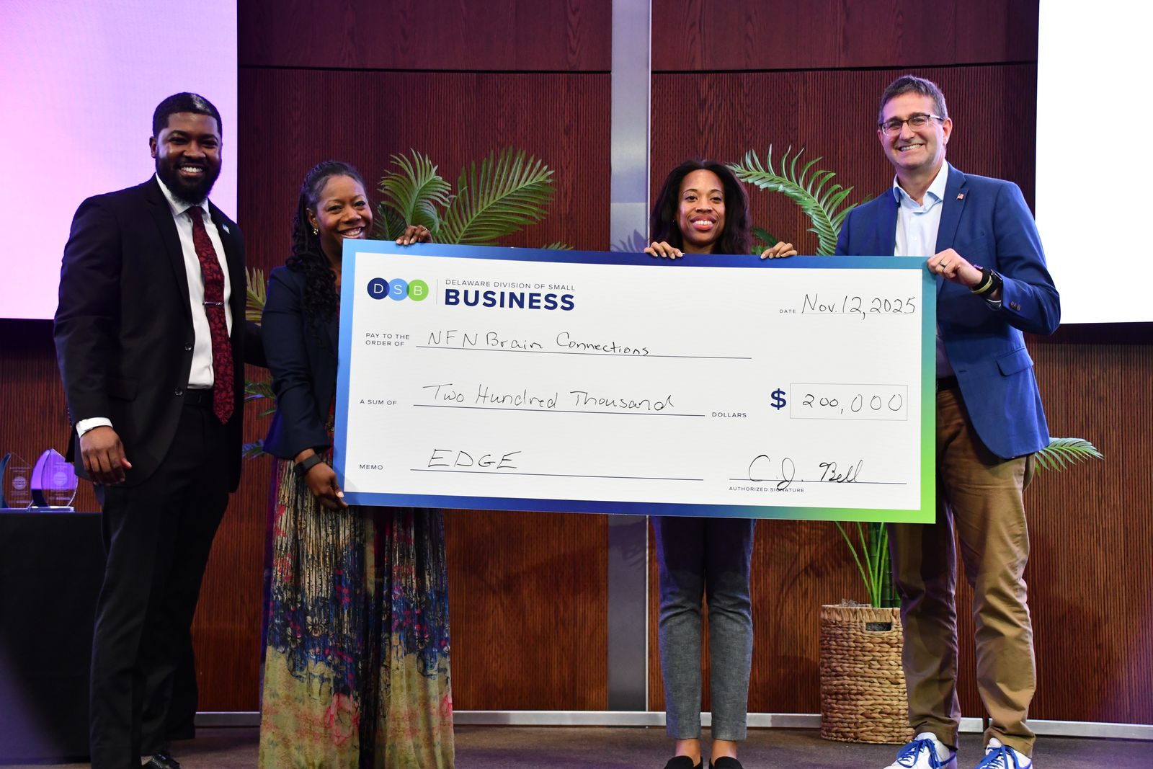
About EDGE 2.0
EDGE is the Delaware Division of Small Business flagship program. Since its inception in 2019 a total of 129 businesses have been awarded a total amount of $9.1 million.
NFN Brain Connection Dover, DE
Notes:
JOE

Slide 4
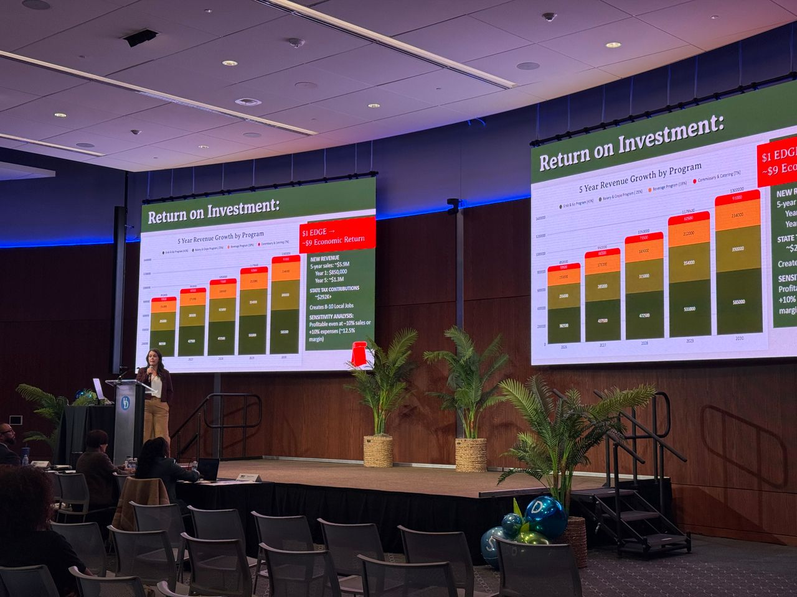

EDGE 2.0
Entrepreneur Track: up to $400K total split among category winners
STEM Track: Up to $750K total, split among category winners
Up to 18 potential awardees
Scaled award amounts based on quality of finalist pitch presentation
All finalists will receive scoping services for a comprehensive business assessment.
Juniper Market Milton, DE
Notes:
There are two categories for prize funding: Entrepreneur (up to $400,000) and STEM (up to $750,000), with a total of 18 finalist to pitch for scaled funding. All finalists will receive scoping services for a comprehensive business assessment.
JOE

Slide 5
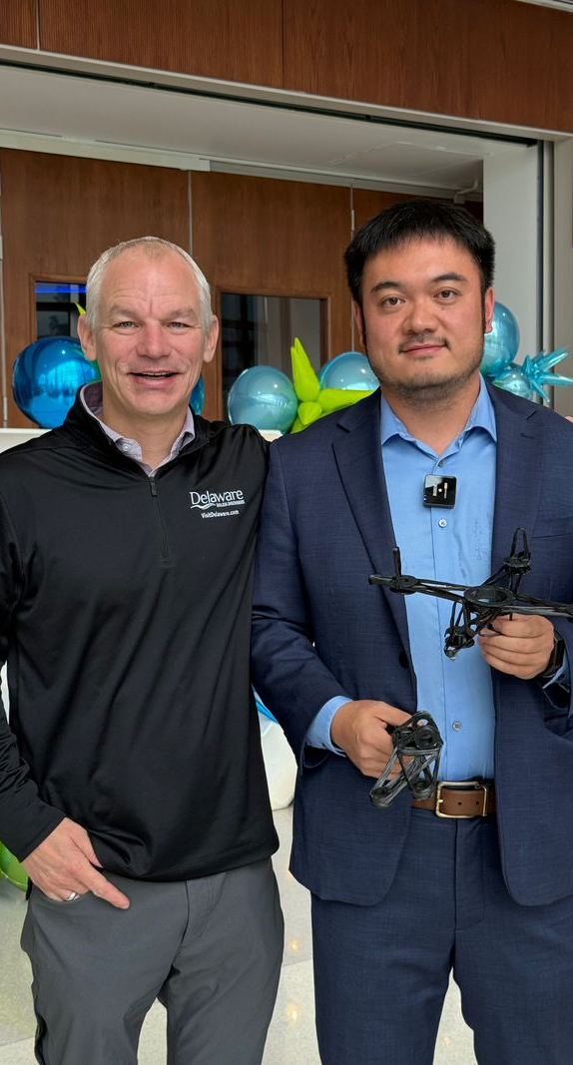
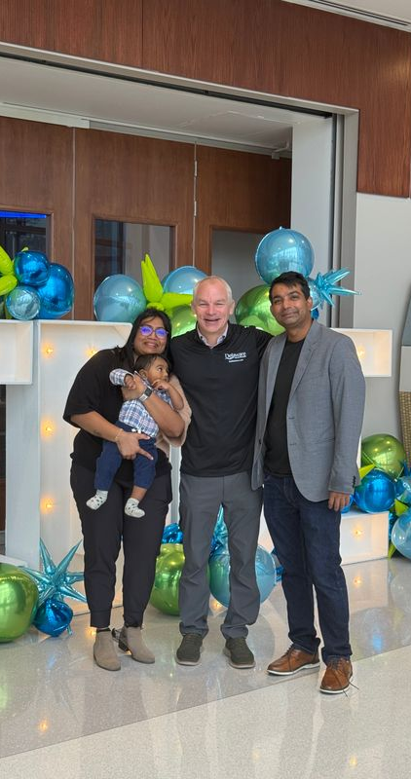
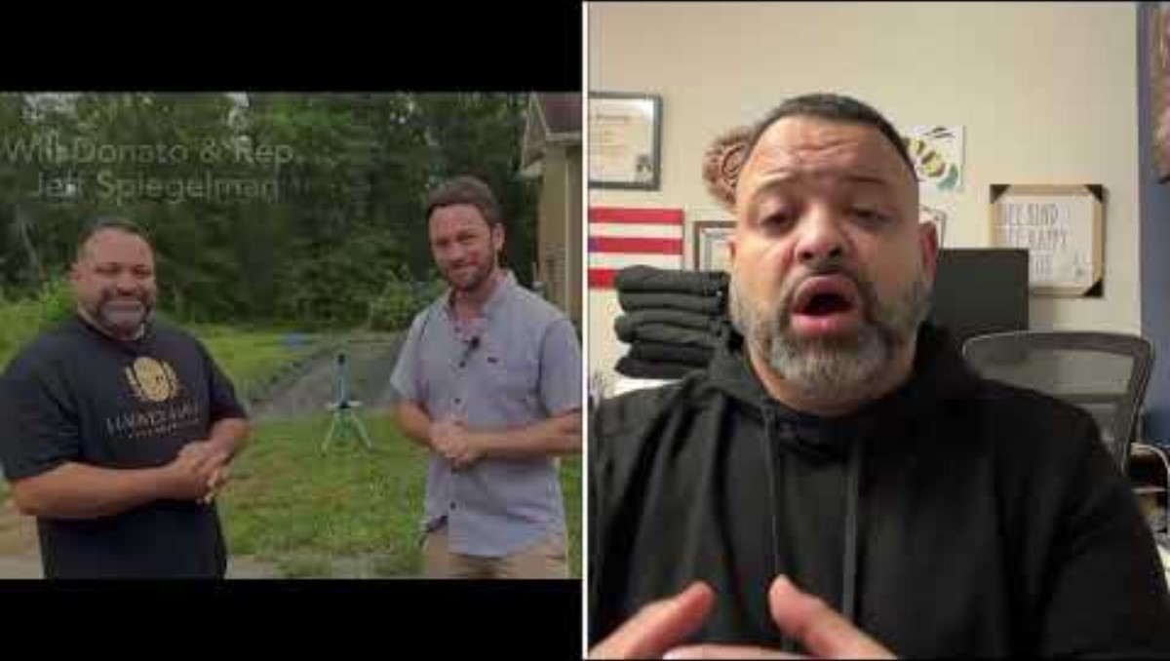
EDGE 2.0
Finalist and Recipients
Notes:
Waiting on video from Harvey Haven to add under EDGE finalist and Recipients
JOE

Slide 6
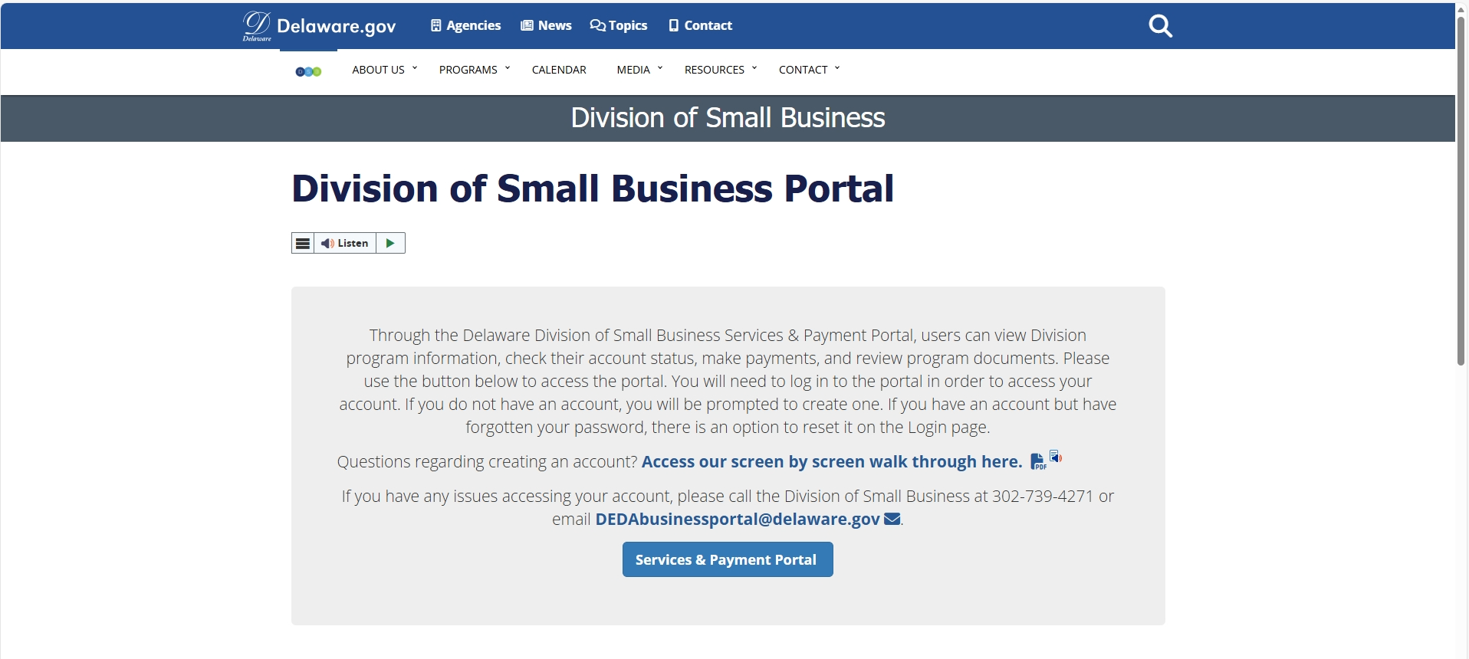
Online Application Requirements
Notes:
(JJ starts Presenting) New applicants create account existing applicants can use same login. If you have any technical issues, email business@delaware.gov? Finance Dept email?

Slide 7

EDGE Grant Portal
Notes:
In order to access the portal you start by creating an account. If you have applied before you do NOT need to create a new account. You will see a screen with all of our program offerings this is a snapshot of the EDGE program portal.

Slide 8
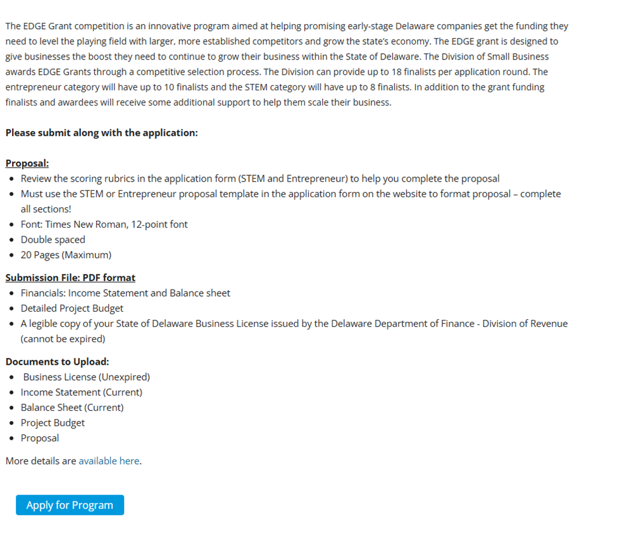
EDGE Submission Requirements
Notes:
Once you have successfully submitted your application and proposal this is what you will see. For additional how-to information for the EDGE application please visit de.gov/EDGE select resources to review previously recorded webinar with detailed step by step walk through from our Divisions Finance Director JJ Moore. DEDAbusinessportal@delaware.gov

Slide 9
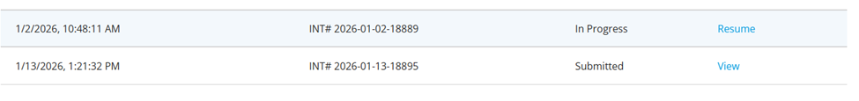
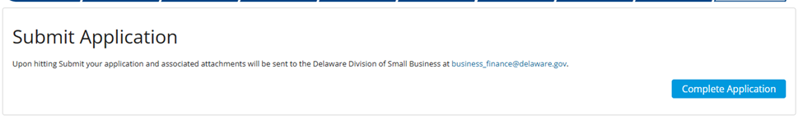
EDGE Grant Portal
Notes:
Difference between in progress and submitted.

Slide 10
How to Complete Your Proposal
Notes:
GEMINI

Slide 11
Formatting Your Proposal
  Must use STEM or Entrepreneur template on website to format proposal – complete all sections! Type of business determines which template you use.
  Font: Times New Roman, 12 Point
  Double-Spaced
  Up to 20-pages
  Save as PDF and upload when completing application
Notes:
Gemini

Slide 12
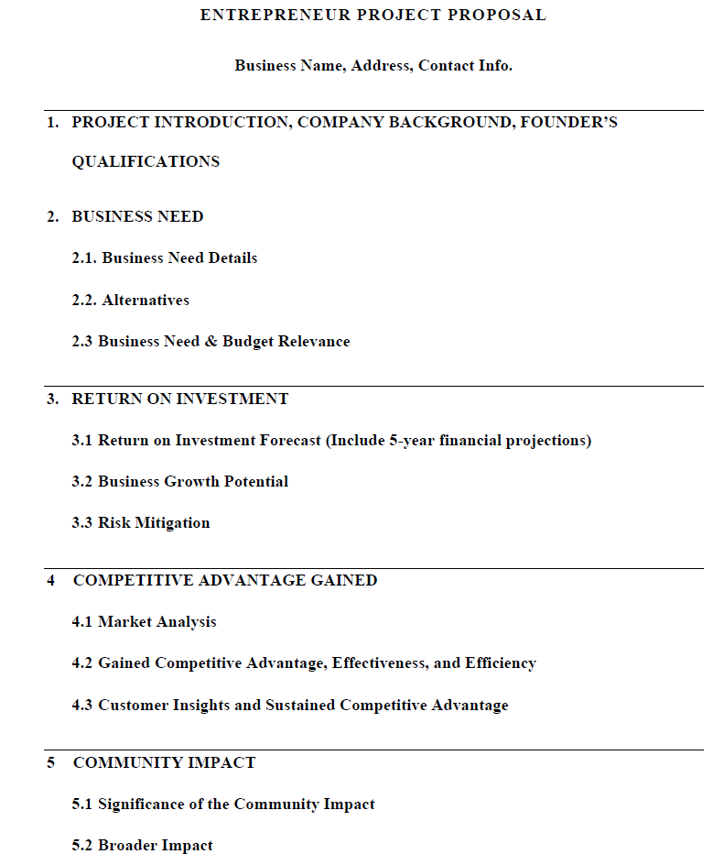
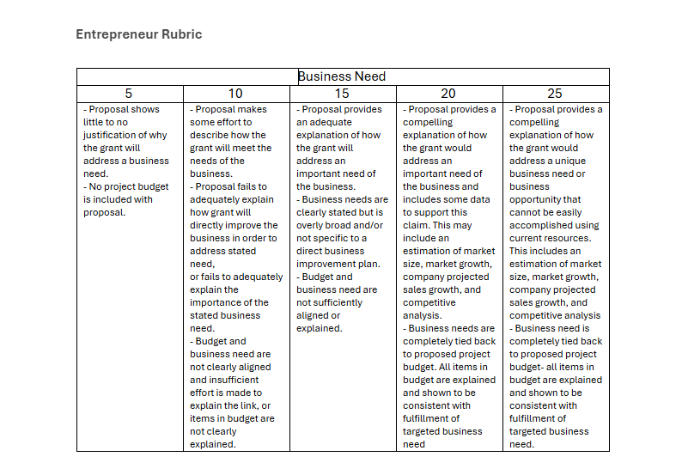
Notes:
Gemini

Slide 13
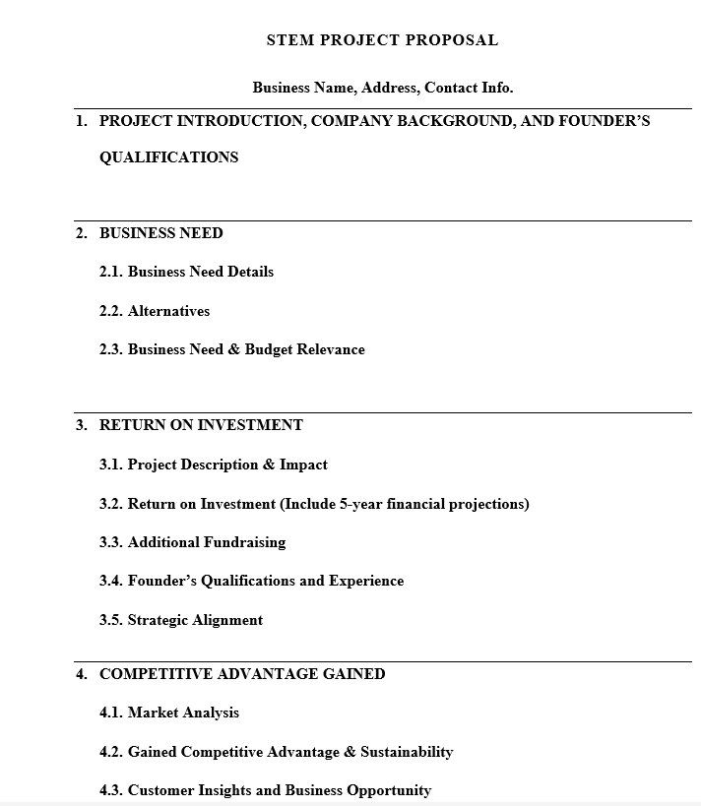
Notes:
Gemini

Slide 14
4 Documents You Need to Upload
Income Statement - pdf
Balance Sheet – pdf
Detailed Budget - pdf
Copy of Current (non-expired) STATE OF DELAWARE Business License (Temporary Licenses accepted if current) – pdf preferred, jpg accepted
Notes:
GEMINI

Slide 15
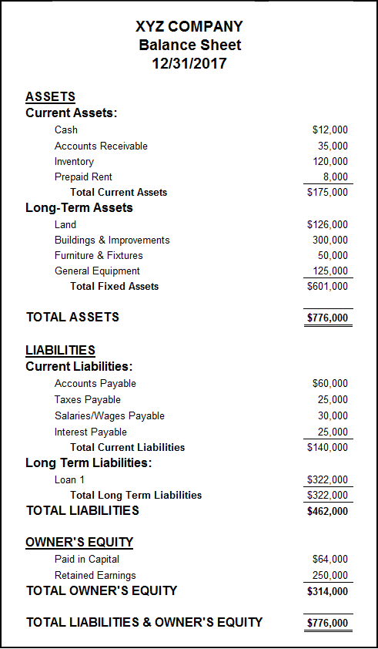
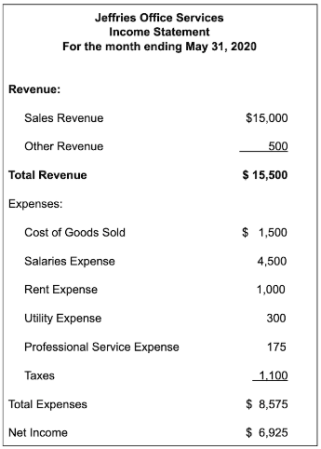
Balance Sheet vs Income Statement
Notes:
Gemini

Slide 16
Balance Sheet v. Income Statement
The balance sheet is a snapshot of what your business owns (assets) and how those things were funded (liabilities vs equity).
Remember, a balance sheet shows the items at the price they were purchased for or the cost incurred to make them. If you can’t put a price on it, it probably doesn’t belong on the balance sheet!
The income statement shows the flow of revenues against expenses for a given period and shows the bottom line - profit or loss.
Your business may not be making a profit yet, and that’s ok. Just remember to be as detailed as you can be in the financials and the narrative.
Notes:
The income statement outlines your business sales and expenses. Creditors use this to determine the profitability of your business. Creditors use this statement to determine if your business will be able to make loan payments. Income statements cover a “period of time”.
The balance sheet outlines your business assets, liabilities and owners equity. Owners Equity is a business net worth. Creditors use this statement to determine the value of your business, your assets that support your business operations and your business debts. Balance Sheet is a “point in time.”
GEMINI

Slide 17
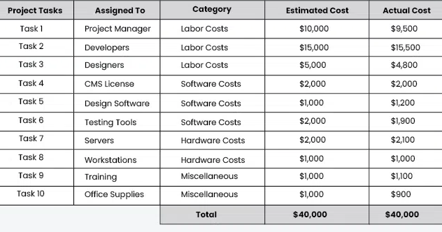
Detailed Project Budget
EDGE Funding
Business Match
$2,000
$2,000
$2,000
$1,333
$1,000
$1,000
$1,000
$1,000
$1,000
$1,000
$13,333.33
Notes:
Detailed project budget supports your financial planning for use of EDGE Grant funds. Please be sure to include a section breaking down your company match that balances out 3 to 1.

Slide 18
3 to 1 Match (found in application form)
When applying you are required to show you have some level of capital
All awards require a 3:1 funding match. For example, to receive a $90,000 grant, a finalist must have secured $30,000 from other sources.
Match should be specific to this project
Other grants can be used for your match
Notes:
AJ

Slide 19
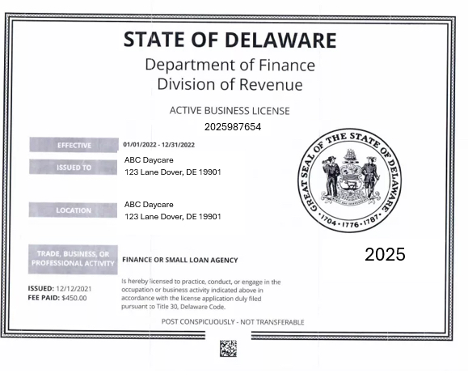
Example of Business License
https://onestop.delaware.gov/
01/01/2026-12/31/2026
2026
01/01/2026
$75.00
Notes:
Up to date state of Delaware business license. Temporary business license is acceptable as long as its not EXPIRED.
GEMINI

Slide 20
Eligible Projects
vs.
Ineligible Projects
Building infrastructure/cosmetic enhancements
Essential equipment
Rent assistance
Web site design
Market analysis assistance
Advertising assistance
Payroll expenses that are not attributed to the project outlined in the application
Salaries or payments made to company ownership
The purchase of real estate
Permits or government fees
Taxes
Improvements to residential property
Notes:
Please note your business must be Delaware based (>51%) have been in operation for less than seven years and have 15 or fewer full-time employees (2 pt employees=1 FT)
GEMINI

Slide 21
Additional Points on the application
MWVSDVIWDBE Status | Opportunity Zones
MBE Minority Business Enterprise WBE Woman Business Enterprise VOBE Veteran Owned Business Enterprise SDVOBE Service Disabled Veteran Owned Business Enterprise IWDBE Individuals with Disabilities Owned Business Enterprise | Must show evidence that a Business is or will be located in a priority geographical area (Opportunity Zone and/or Downtown Development District).
Additional Points:
An additional five points each will be given if the business demonstrates its M/W/V/SDV/IWDBE Status OR is located in an Opportunity Zone or Downtown Development District and another five points will be given if a business is a Governor’s Industry of Interest.
Notes:
Max bonus points 10
ANASTASIA

Slide 22
Governor’s Industry Of Interest
Fintech
This sector aims to increase efficiency, accessibility, and convenience in financial transactions and services.
Payment processing, peer-to-peer lending, robo-advisors and block chain technology, etc.
Bio Pharmaceutical Manufacturing
Develops manufacturing of pharmaceuticals can lead to job creation in high skill sectors, increased exports and improved public health, reducing long term healthcare costs.
Vaccine production, biotechnology firms, generic drug manufacturing, etc.
Agriculture
Organic farming, precision agriculture, agribusiness supply chains, etc.
Notes:
AJ

Slide 23
Governor’s Industry Of Interest
Blue Tech
Blue tech is framed as technology used to understand, explore, and manage the marine environment, with tools such as autonomous surface vessels, underwater robotics, geospatial mapping, sensor networks. Promotes sustainable practices and increases coastal community revenues.
Aquaculture technology, marine renewable energy ( tidal and wave energy), oceanographic research , etc.
Tourism
Accommodations, Transportation (bus, car rental etc.), Attractions, Restaurants,
Notes:
AJ

Slide 24
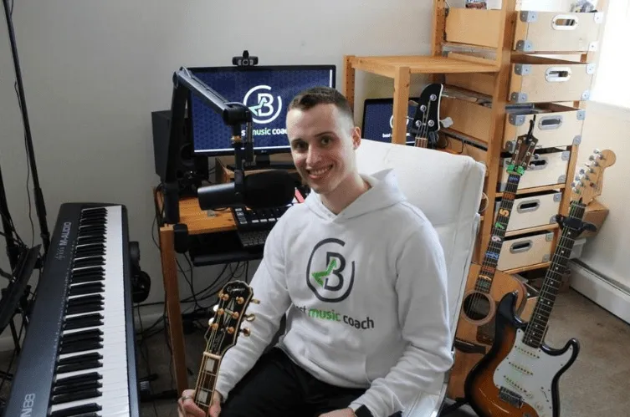

Governor’s Industry Of Interest
Recreation
Recreational facilities and services that can improve community health and wellness while generating revenue.
Fitness centers, gyms, outdoor adventure services (hiking, kayaking, biking) etc.
Entertainment
Theatrical productions, media, film, music, producers, performing arts ,art exhibits, and other creative endeavors that are central to Delaware's vibrant arts community.
Notes:
Best Music Coach EDGE Recipient 2019

Slide 25
Tips
Meet with a Business Manager to get guidance and feedback on your proposal
Sign up with a resource partner for guidance and feedback
Do not request the upper limit of the available pot
Remember – you need to have a match for the amount you request
Once you submit your EDGE proposal create a pitch deck
Practice pitching your funding request to family and friends and get feedback (15 minutes or less)
If you don’t make it to pitch round attend and take notes on presentation styles and judge's feedback
Notes:
Anastasia Slides 25-36

Slide 26

Deadline for applications
Friday, March 6, 2026 4:00 p.m.
Do Not Wait Until the Last Minute!!
Finalist notification: April 2, 2026
Pitch Dates: April 30, 2026 (Entre) May 1, 2026 (STEM)
Award Ceremony: May 12, 2026
Notes:
Notification for unsuccessful applicant score review can start scheduling starts June 2026
add Del one conference center?

Slide 27
After Application Submission
Four rounds of internal review and scoring
Judging on two separate days – one for STEM, one for Entrepreneur

Slide 28
After Award
Sign grant agreements
Confirm compliance before we disburse the funds
Reporting requirements afterward
  5-year commitment to remain in state
EDGE Grants are considered taxable income. Consult an accountant if you have questions about your specific situation.
Notes:
Compliant with Department of Finance Division of revenue, Department of Labor Unemployment insurance employment and training and DNREC.

Slide 29
Resources and Information
Notes:
AJ

Slide 30
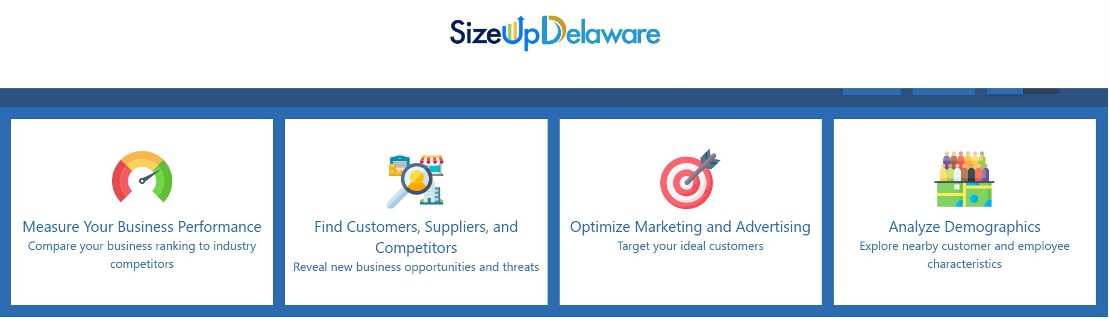
Resource Tool
Use Size Up Delaware for market sizing and information on competition https://delaware.sizeup.com/
Notes:
size up Delaware with Data https://delaware.sizeup.com/
SizeUp Delaware is a free business analytics tool designed to assist small and medium-sized businesses in various stages of growth. It helps users find competitors, identify potential customers, and measure business performance. The tool utilizes data from multiple sources to provide insights and support businesses in making informed decisions to grow their operations.

Slide 31



Resource Partners
Notes:
Trusted Resource Partners
SBDC (Small Business Development Center)
LAUNCHER – hosts EDGE lunch and learns and provide proposal feedback supports
Pete duPont Scoping support for EDGE Finalist

Slide 32

Office of Supplier Diversity
  W/M/V/SDV/IWDBE Certification
  On the application, you self-identify that you are in a certain W/M/V/IBE category. (women/minority/etc.)
  Assistance with state procurement opportunities
OSD Director – Shavonne H. White
osd@delaware.gov
  De.gov/osd
Notes:
Become Certified as a diverse supplier (minority, women, veteran, service-disabled veteran, and individuals with disabilities owned businesses) or a Small Business Focus (SBF) program vendor.

Slide 33

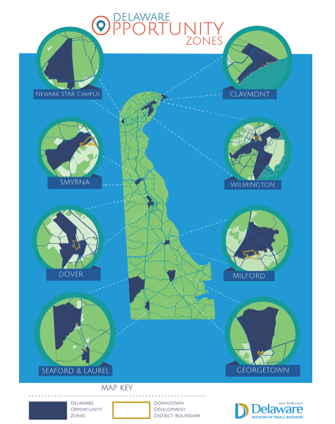
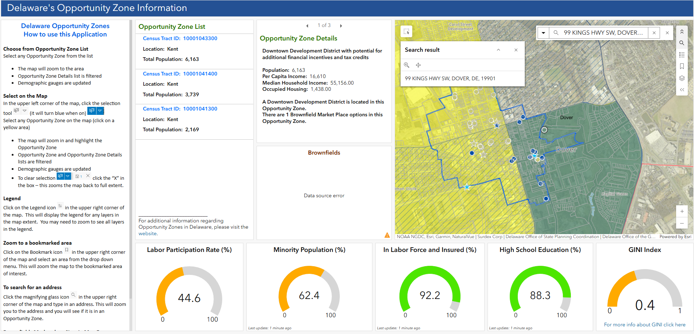
Where can I learn more?
https://business.delaware.gov/opportunity-zones/

Slide 34
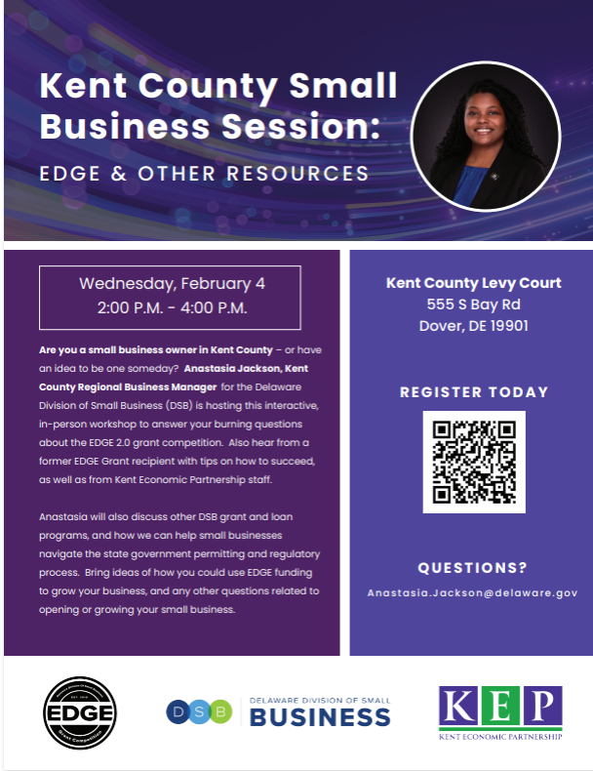
Notes:
Kent County Small Business Outreach Workshop Tickets, Wed, Feb 4, 2026 at 2:00 PM | Eventbrite add reg link in chat box.
Additional resource workshops coming soon sign up for our weekly newsletter to stay up to date on events, small business trainings and workshops.

Slide 35
Business Managers
Joe Zilcosky: Joe.Zilcosky@delaware.gov
  Industries: STEM, Fintech, Life Science, Bio Science, Film & Production
  Location: New Castle County
Anastasia Jackson: Anastasia.Jackson@delaware.gov
  Industries: Service-based, Hospitality, Retail, and Restaurant
  Location: Kent County
Gemini Cornish: Gemini.Cornish@delaware.gov
  Industries: Professional Services, Agriculture, Aquaculture, and Consulting
  Location: Sussex County
Notes:
Which of the three should you contact? Look at Industry first. If your industry is not listed, then go by location.

Slide 36
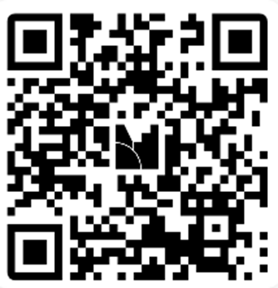
Type any questions into the Q&A
The recording and the slides for this presentation will be posted at de.gov/edge by noon tomorrow.
Join at menti.com | use code 8224 6194
Please join the Menti by scanning the QR code
Notes:
https://www.mentimeter.com/app/presentation/al6kyavqyssbuvgv3yqm99q6igyqag6o/edit?source=share-modal
Anastasia read questions from participants-RBMS answer select 15 questions. Monitor time webinar 1hr?

Slide 37
EDGE 2.0 Informational Webinar
Survey Results
Join at menti.com | use code 8224 6194
Please join the Menti by scanning the QR code
Notes:
https://www.mentimeter.com/app/presentation/al6kyavqyssbuvgv3yqm99q6igyqag6o/edit?source=share-modal
Anastasia read questions from participants-RBMS answer select 15 questions. Monitor time webinar 1hr?

Slide 38



Stay Connected
Sign up for our e-newsletter
  Go to business.Delaware.gov and sign up at the bottom of any page
Follow us on social media:
  @delawaresmallbusiness
  LinkedIn.com/company/de-smallbusiness
  @delawaresmallbusiness

Slide 39
Thank You

